Slide 1
BCCA figures
Feb 18 2025

Slide 2
At least 5 entries – top – to get stats on % of entries or papers on these:

Slide 3
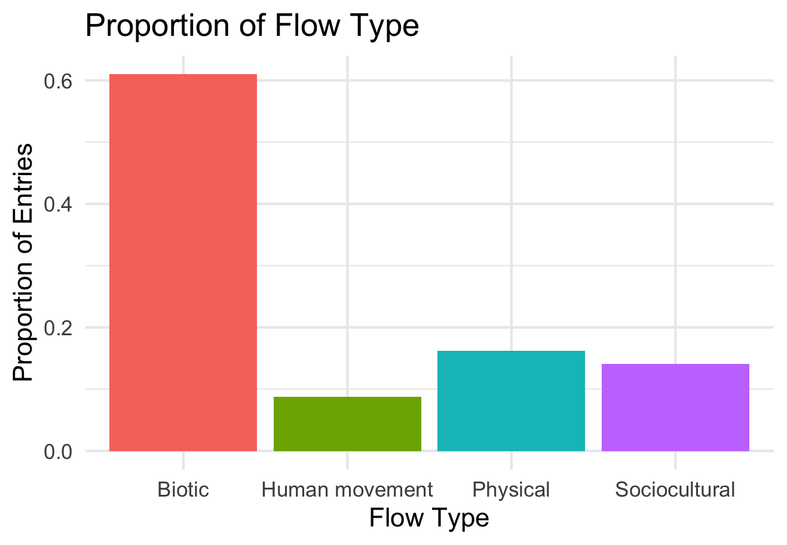

Slide 4
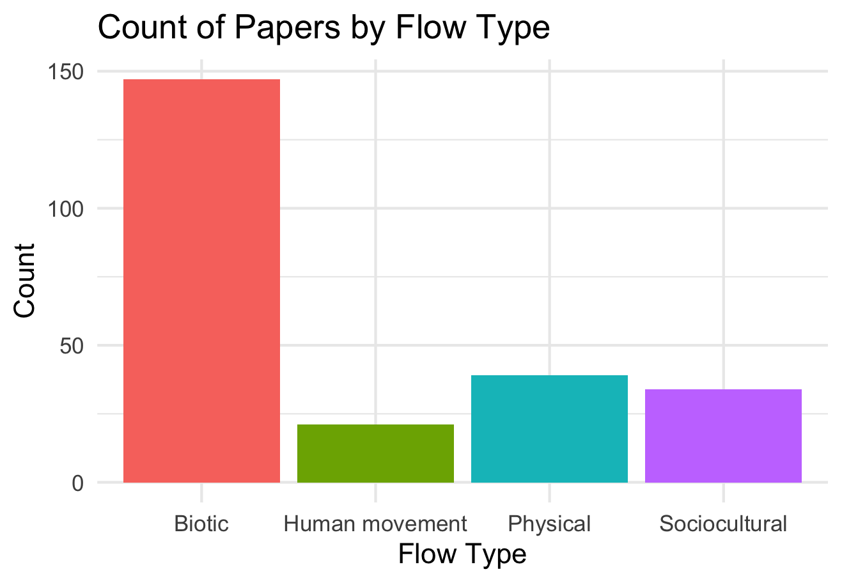

Slide 5
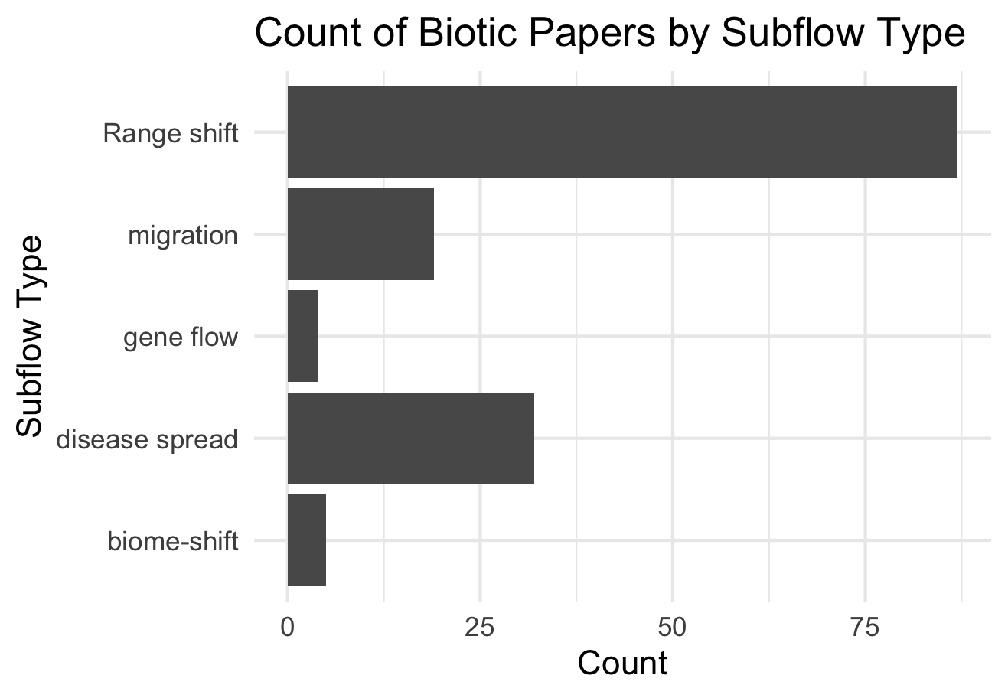

Slide 6
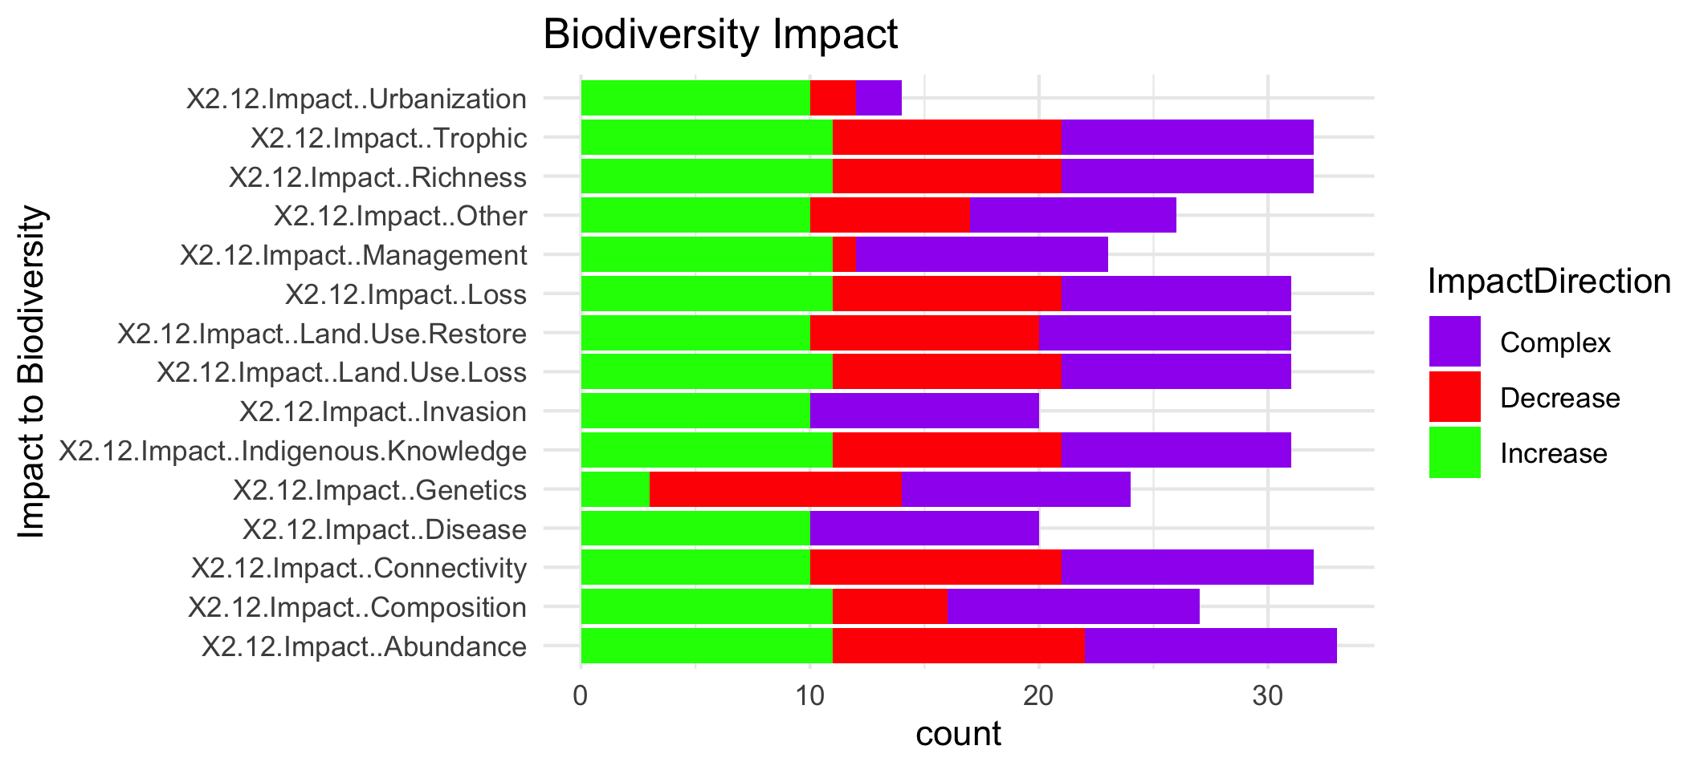

Slide 7
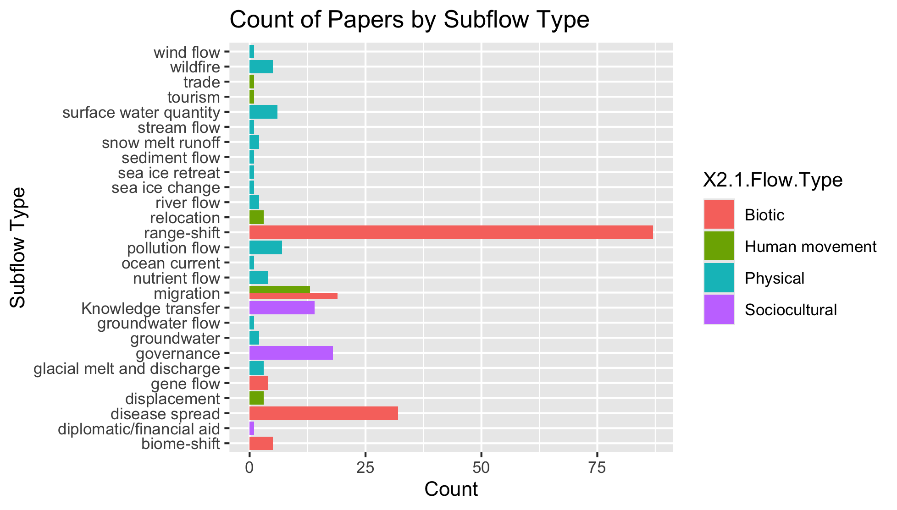
To group physical flow papers

Slide 8
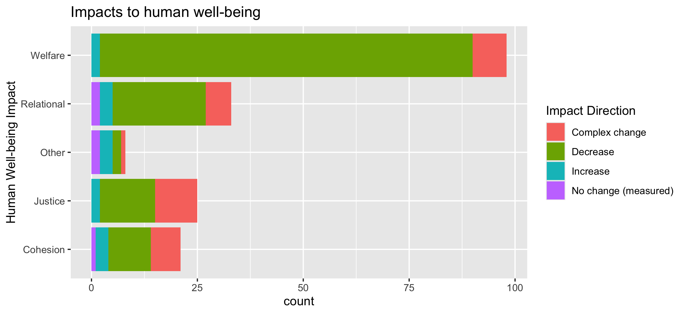
To align direction colors with final color pallet

Slide 9
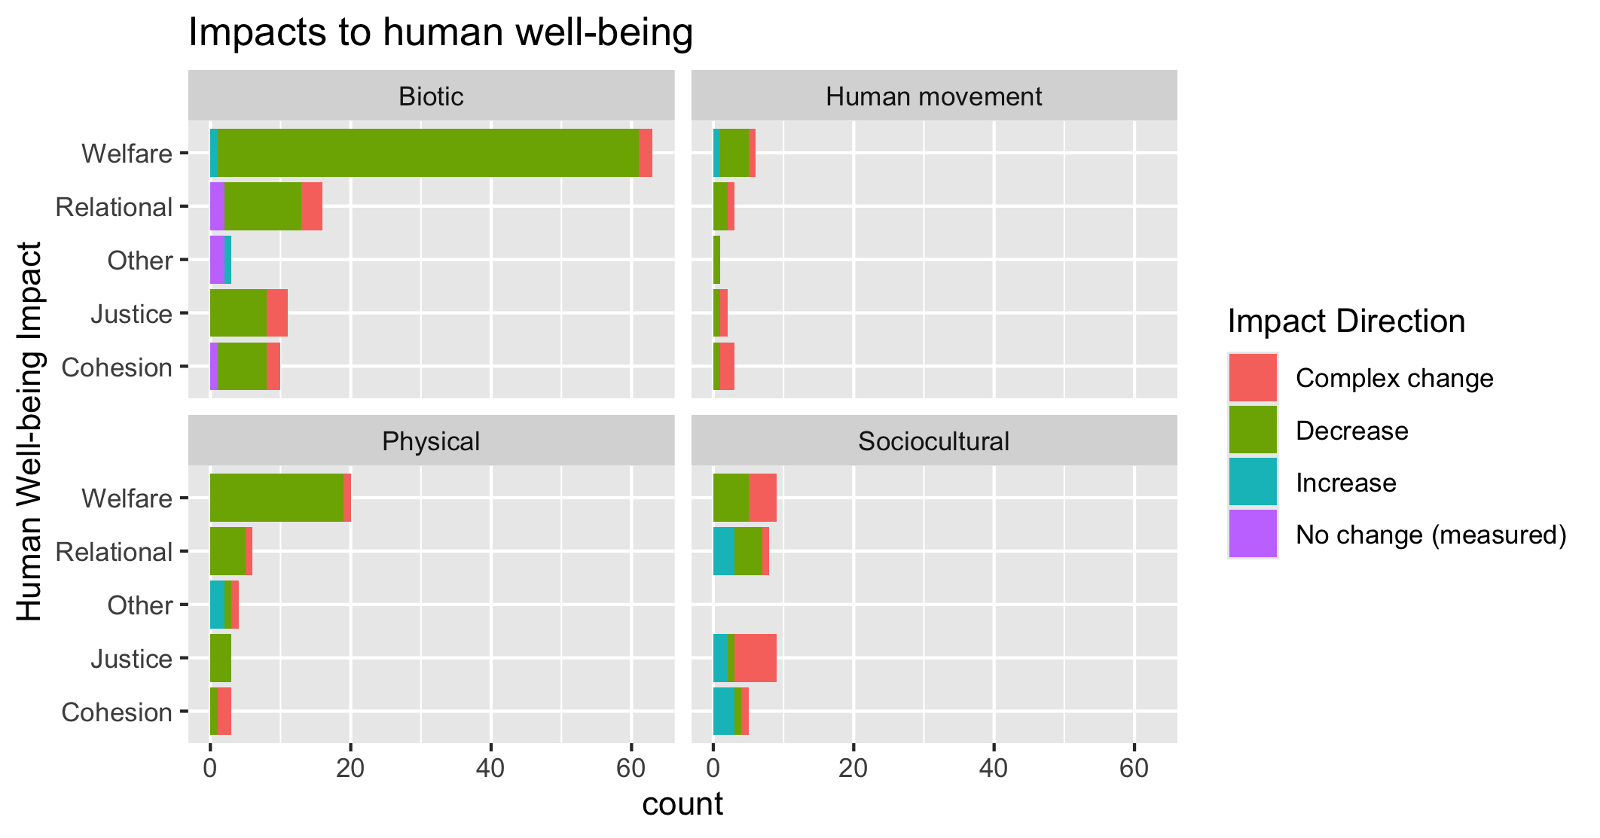
To align direction colors with final color pallet

Slide 10
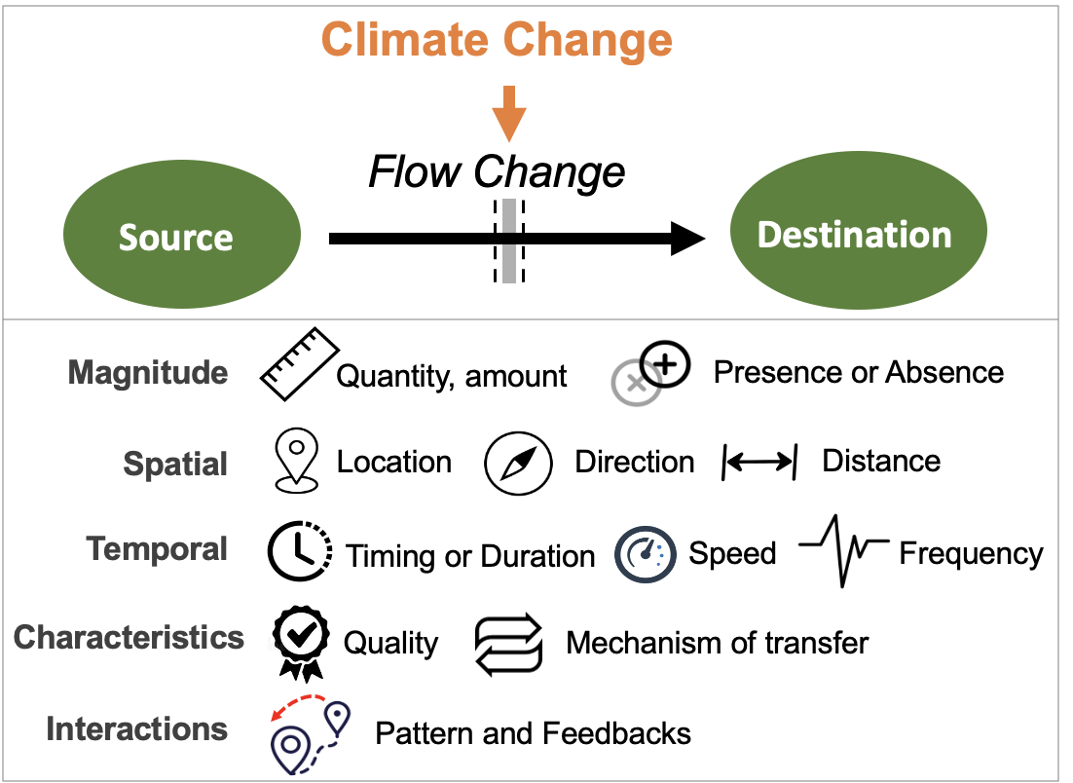
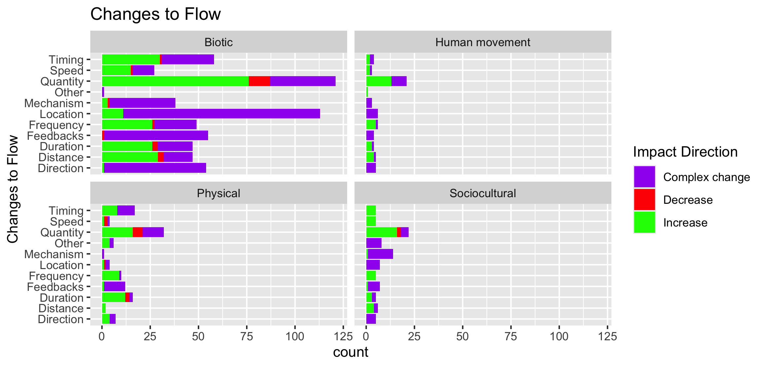

Slide 11
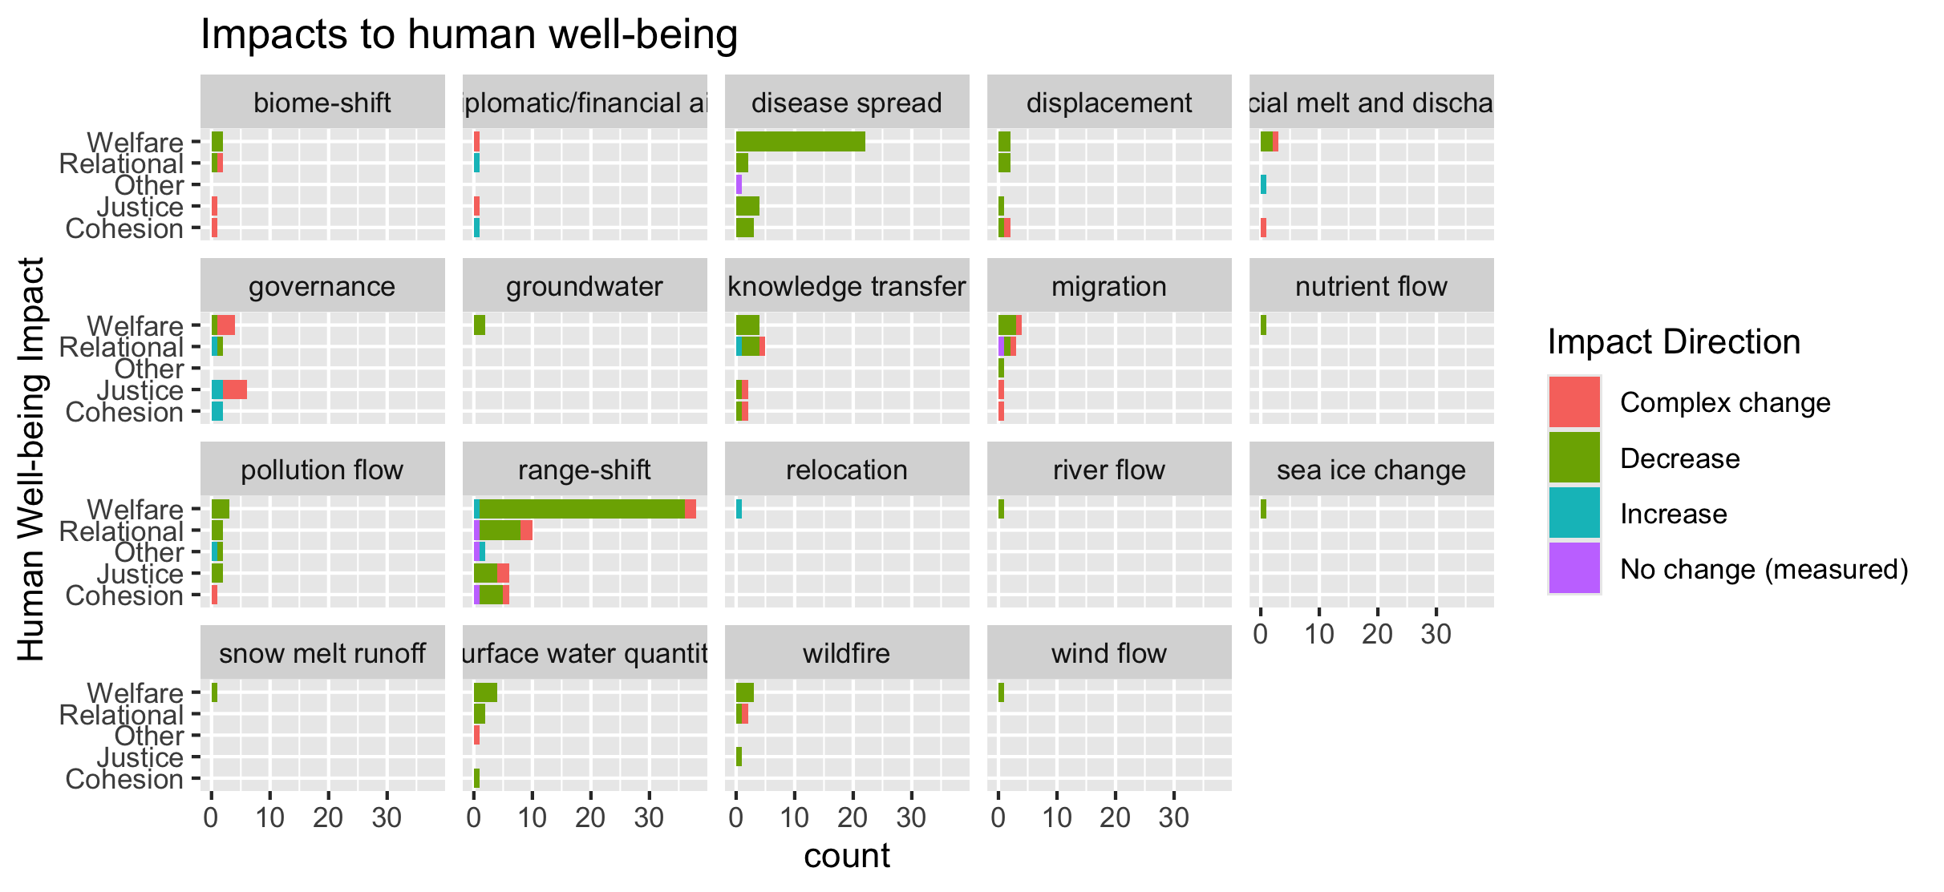
To group physical flow papers

Slide 12
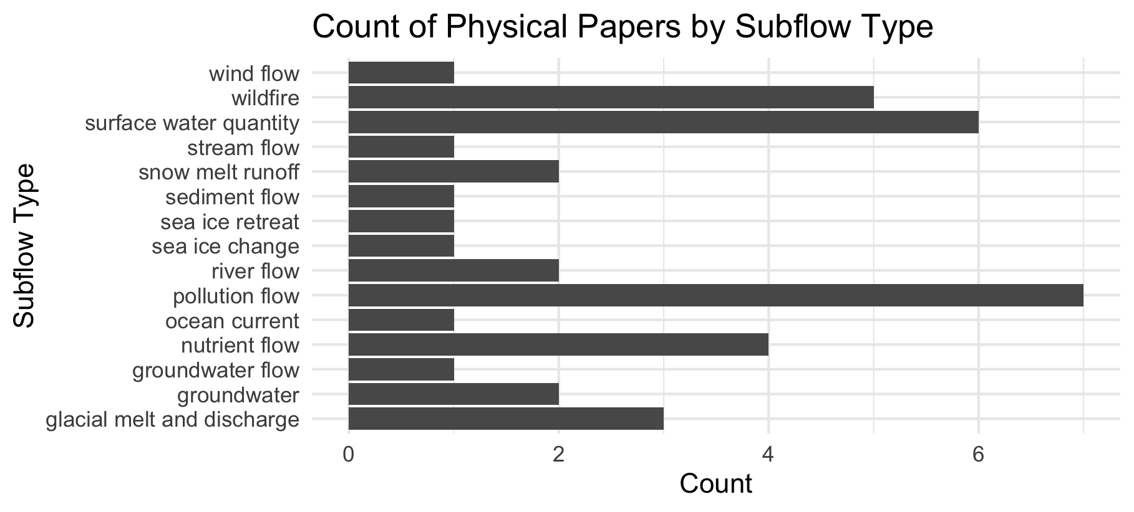

Slide 13
Feb 23 2025

Slide 14
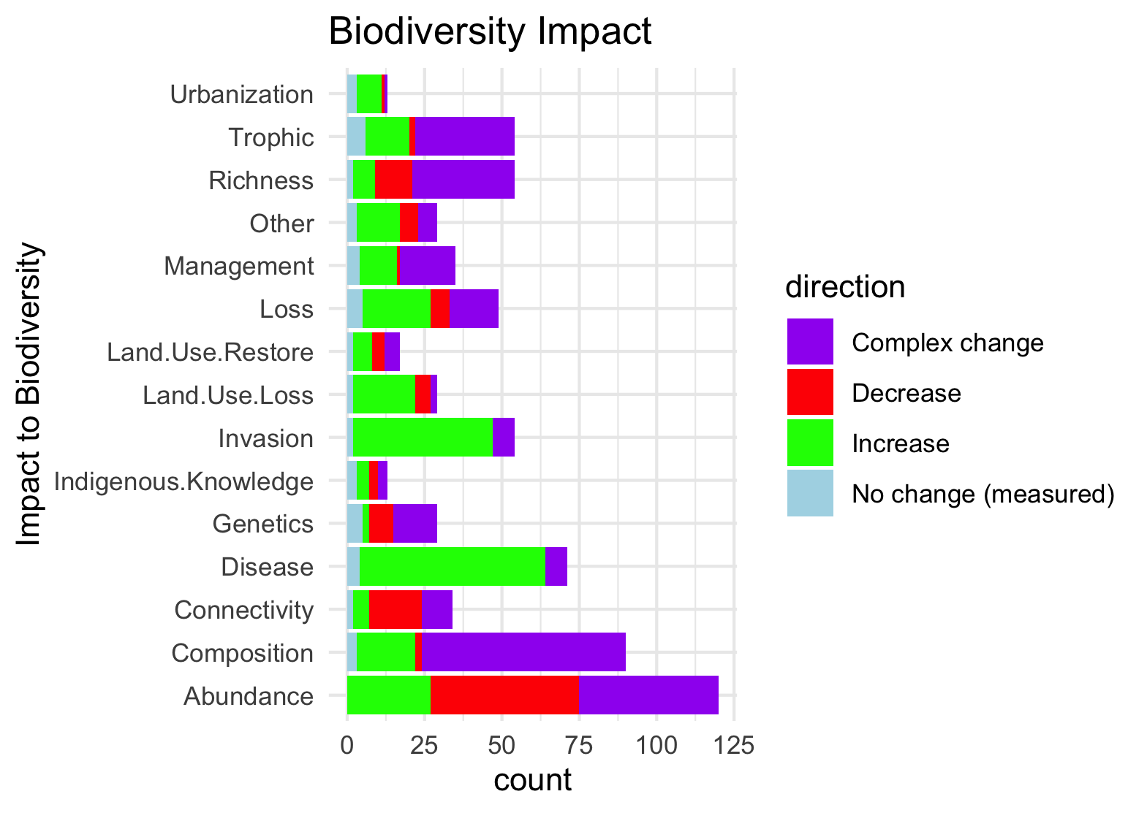
Needs to be grouped by what is good and what is bad to see increase in:

Slide 15
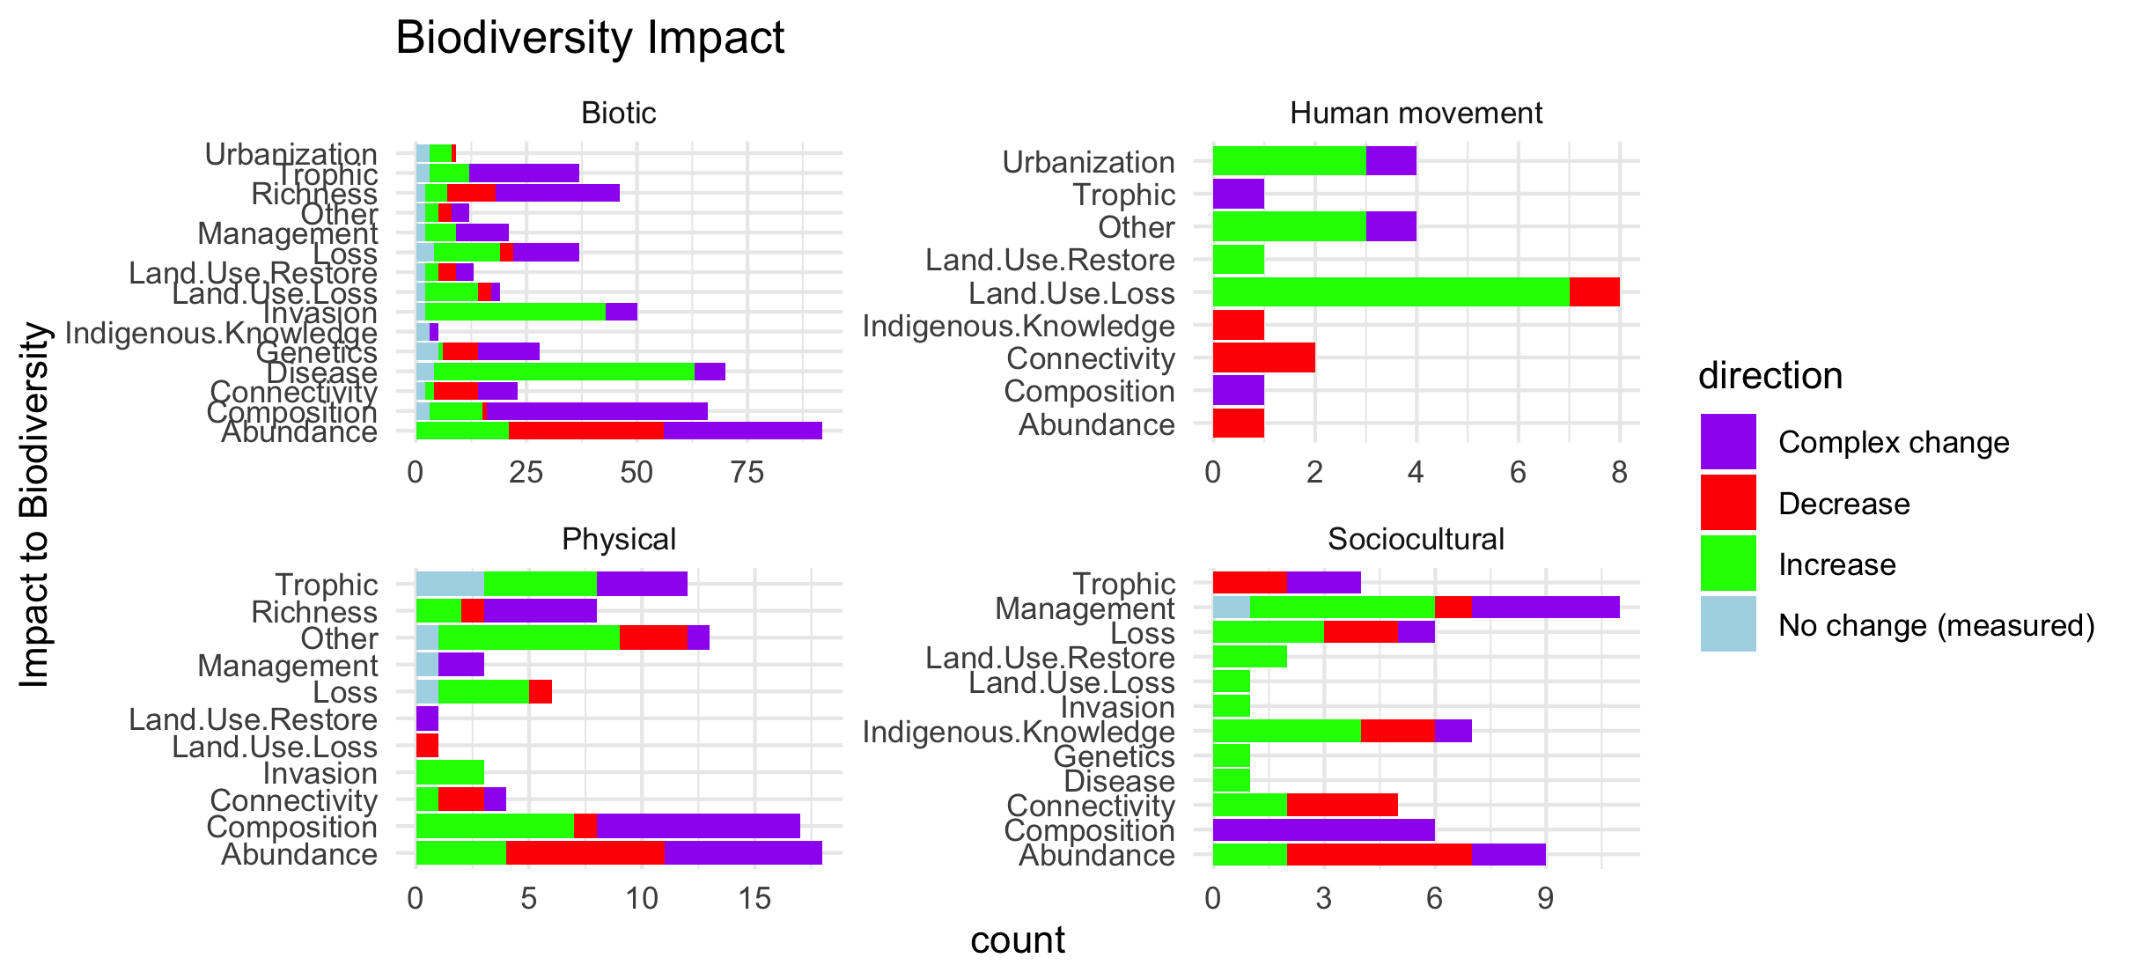
Scale free on the facet (diff x axis)

Slide 16
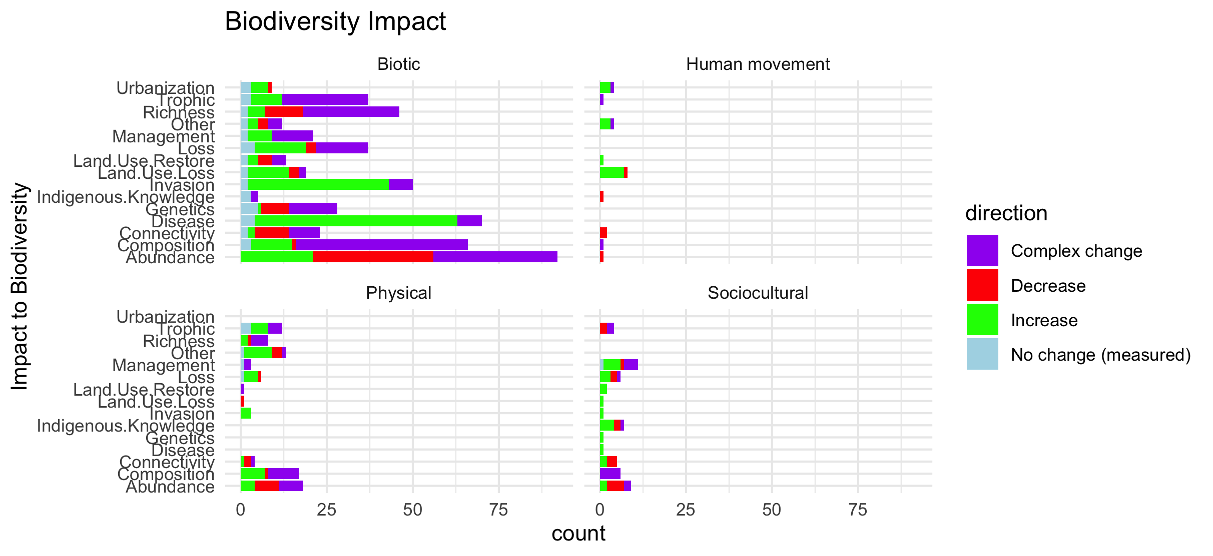
Scale fixed on the facet (same x axis)

Slide 17
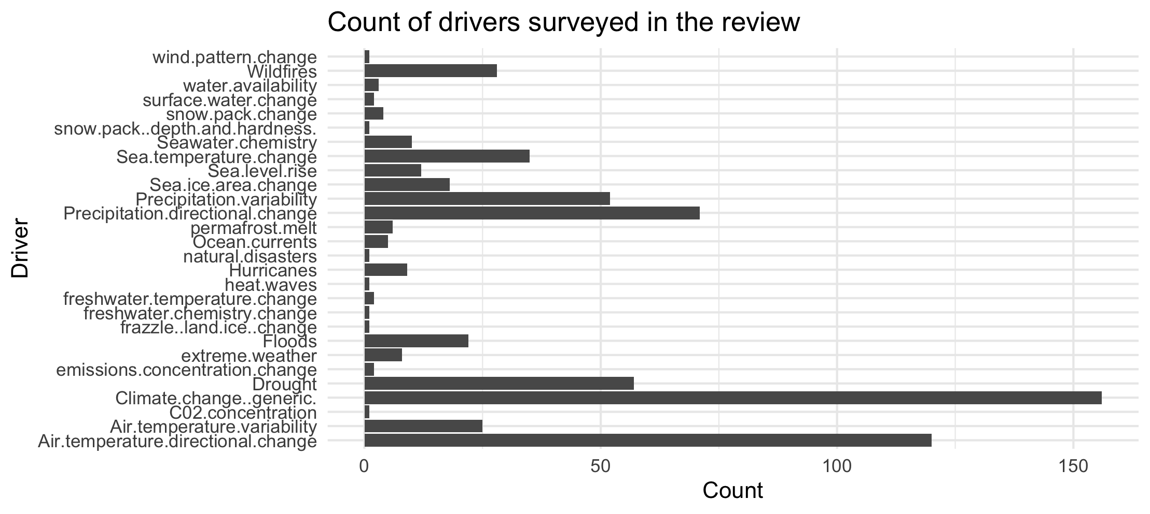

Slide 18
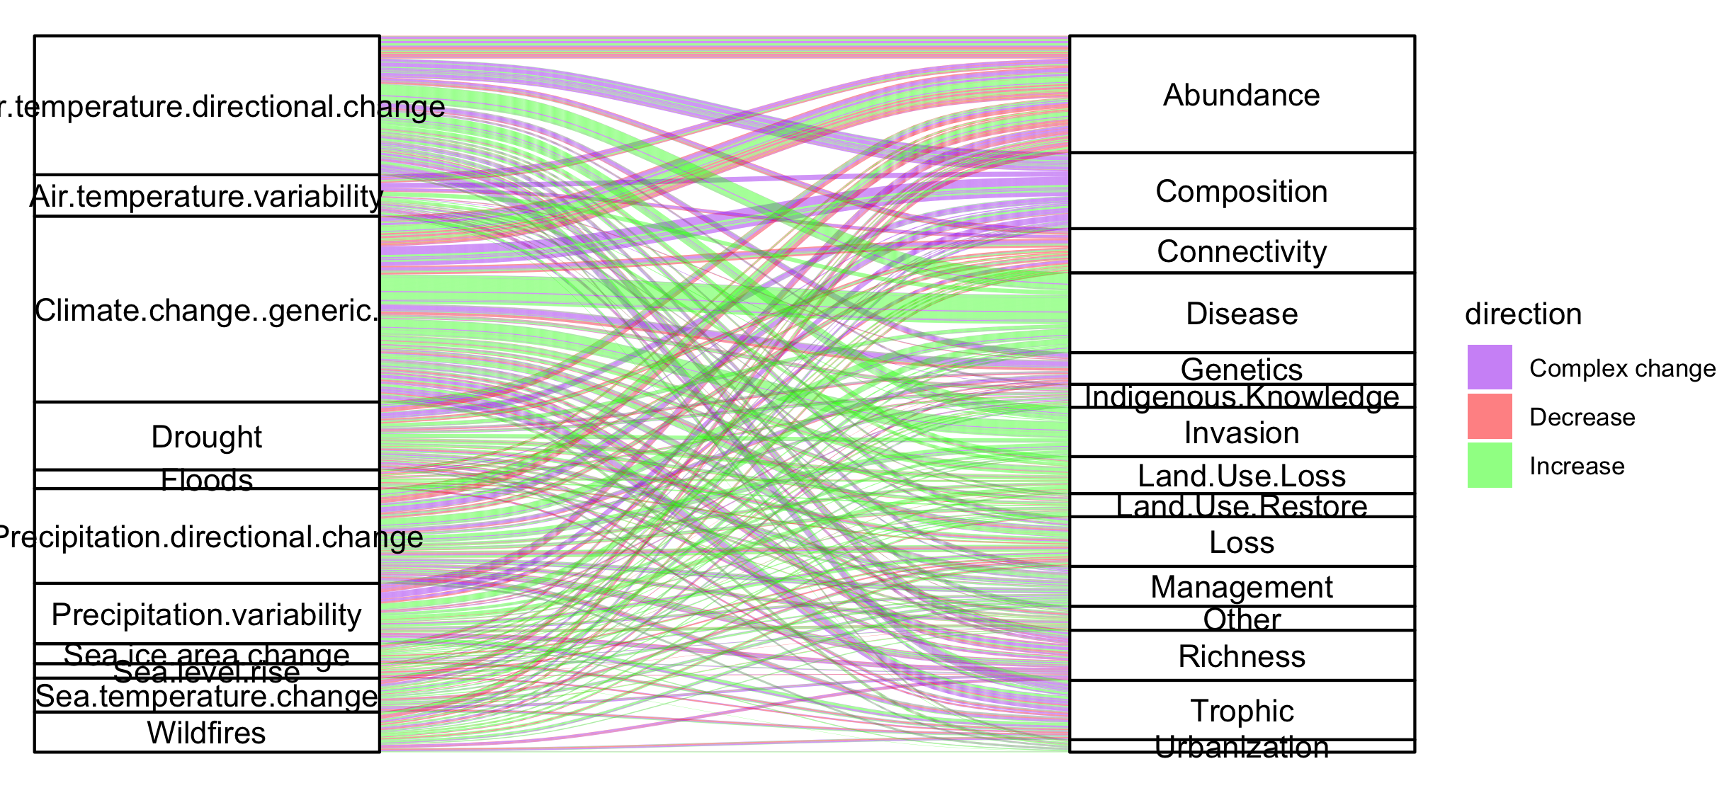
Colleen: see note isn the code – we could group spme of the drivers (hurricaines, extreme weather, ands ome of the ice ones). This still doesnt take into account if changes arw good or bad though and might just be too busy.

Slide 19
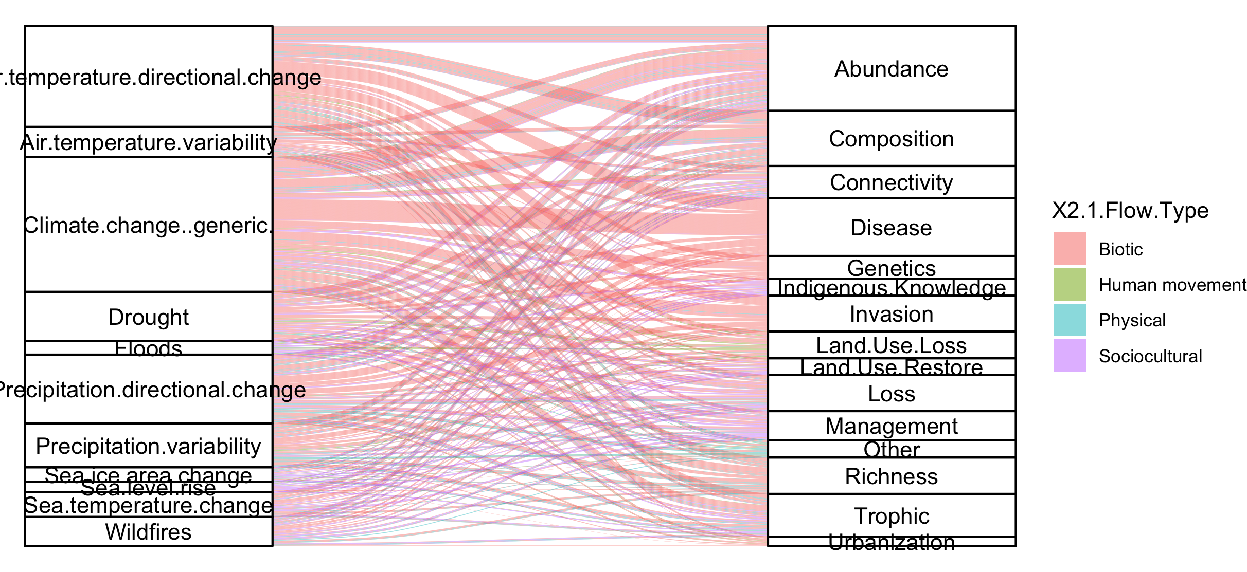
#not that informative because so many more of the papers are biotic

Slide 20
NCPs

Slide 21
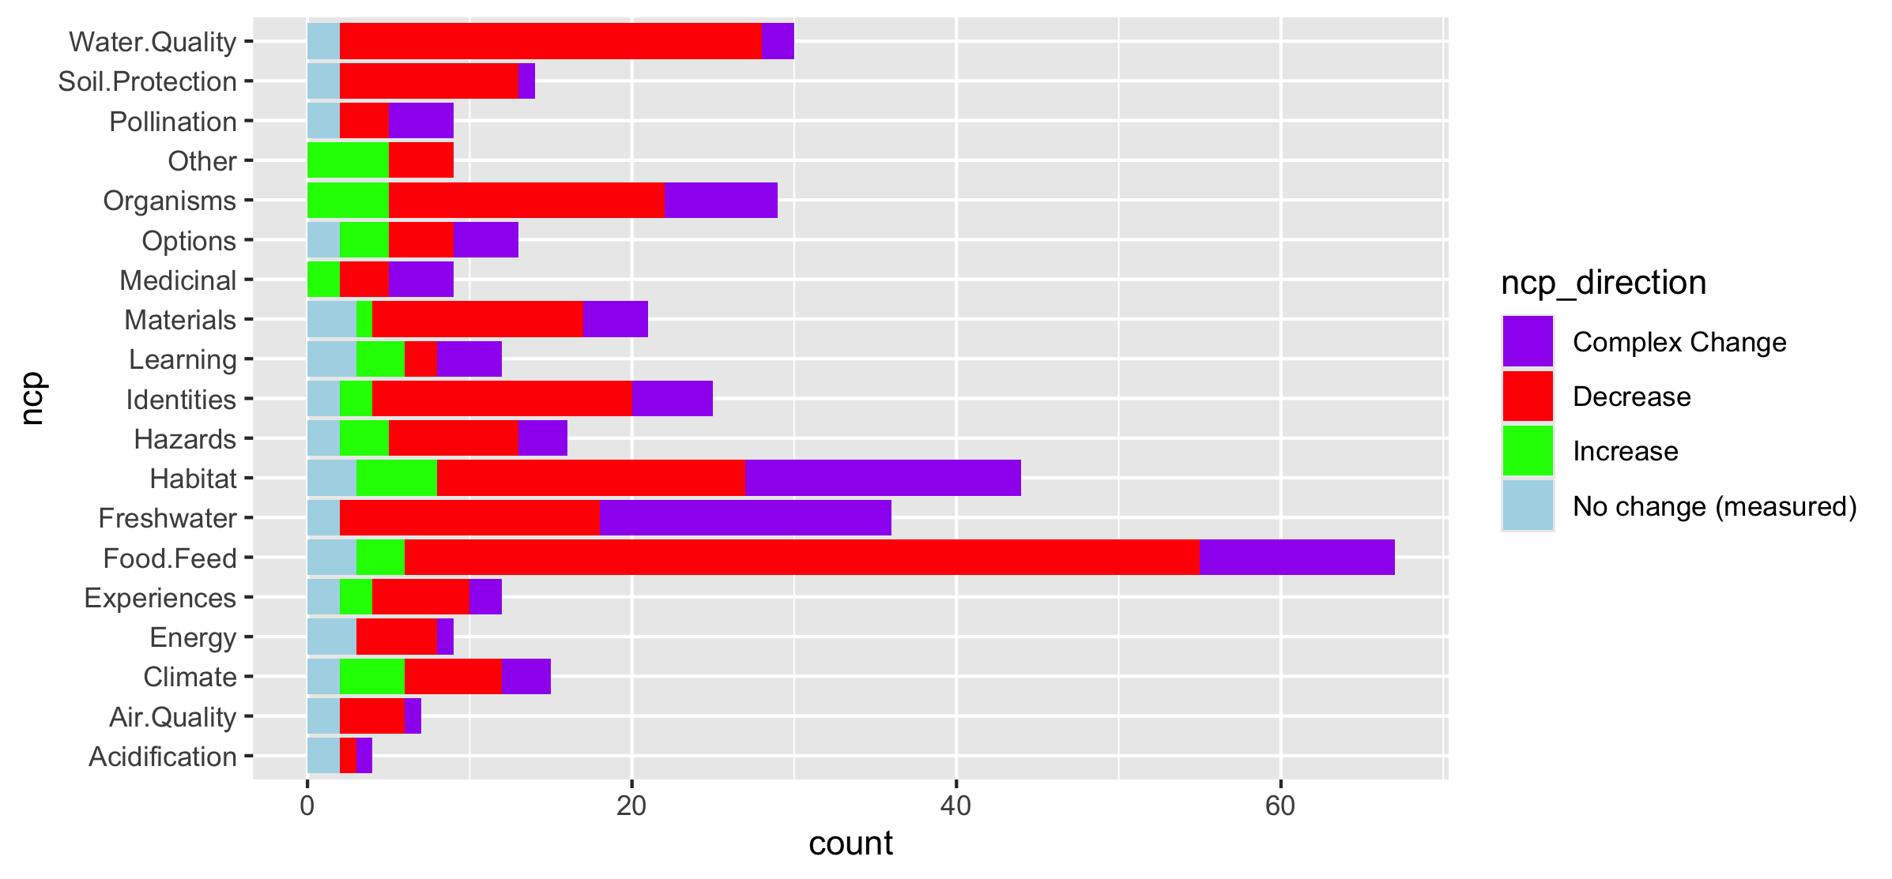
Fix labels

Slide 22
Do by flow type

Slide 23
Fix labels

Slide 24
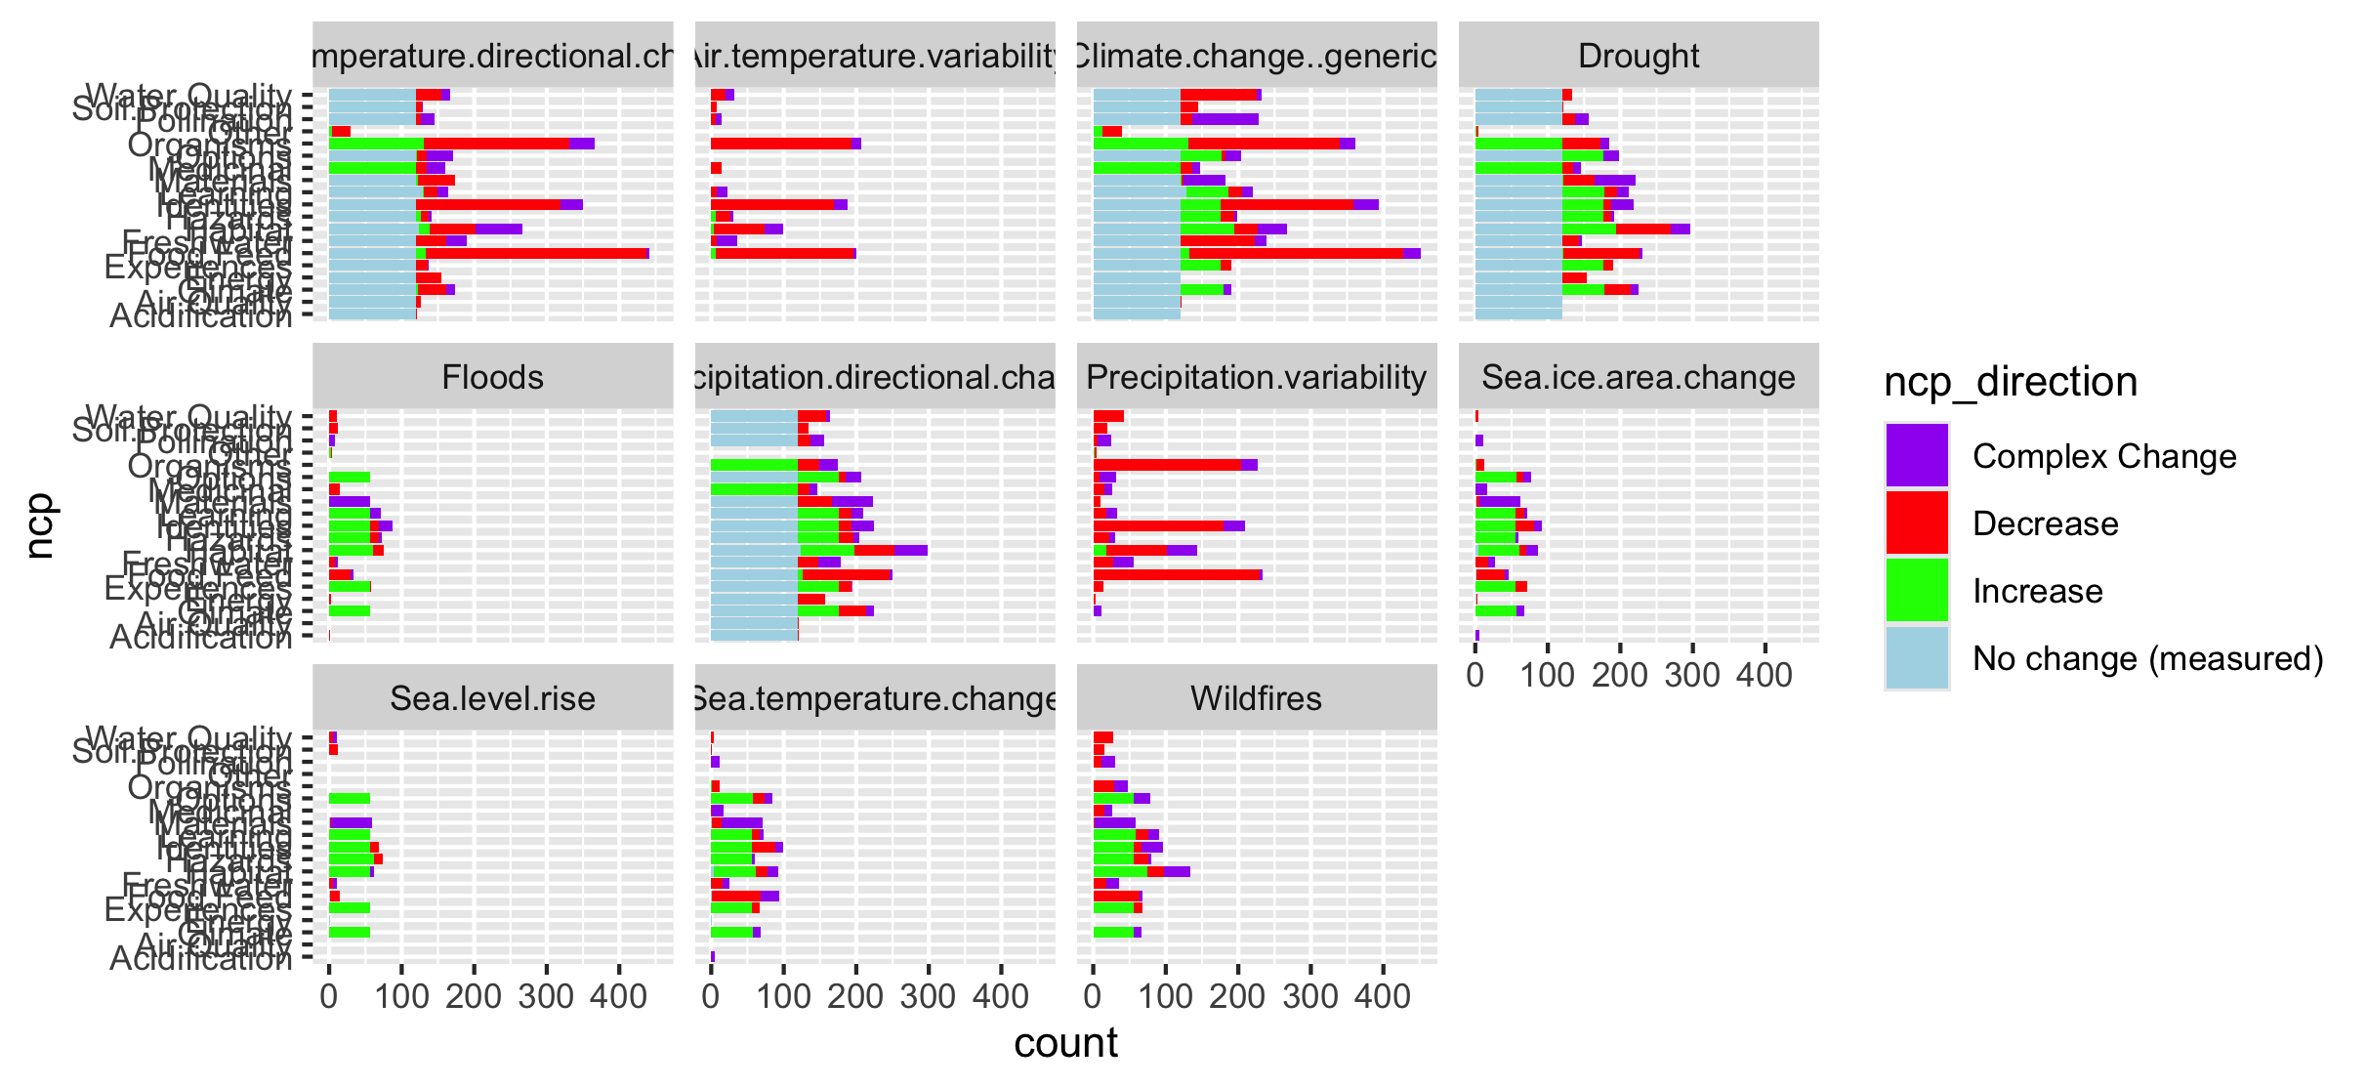

Slide 25
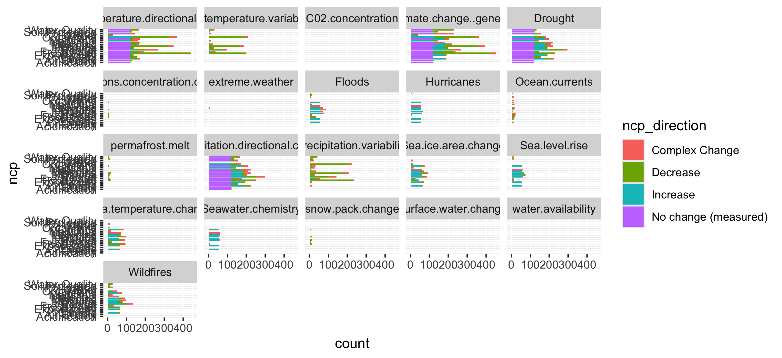
Too many drivers

Slide 26
HWB

Slide 27
Connections – how does altered flow relate
Driver~ altered flow (by flow, and subflow – grouped out by flow
Altered flow~ impact (for each category)

